Slide 1
jQuery
Command Chaining, Ajax and Closure

Slide 2
Review
You can retrieve and change the contents of an html element using the html function:
var x = $(‘#xyz’).html();
$(‘#lue’).html(“Forty Two”);
For control elements – such as the text box and textarea use val to get and put values

Slide 3
Ajax – Sending data
You can make calls to the server from your web browser using $.ajax
You can provide data in a hash list:
$('#add').click(function(){
$.ajax({url:'adduser.php',
data:{who:$('#myname').val() }
});
});

Slide 4
Ajax mechanics
The browser will send the key/value pairs to the server.
In the above example there is no response worth reading.
The script at the server can process the data:
adduser.php
<?php
$fh = fopen('users.txt','a');
fwrite($fh,"$_REQUEST[who]\n");
?>

Slide 5
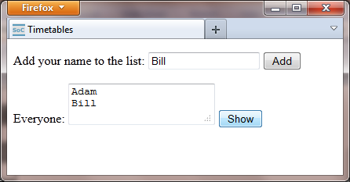
Three components... .html .js .php
<p>Add your name to the list:
<input id='myname'/>
<button id='add'>Add</button>
</p>
<p>Everyone:
<textarea id='everyone'></textarea>
<button id='show'>Show</button>

Slide 6
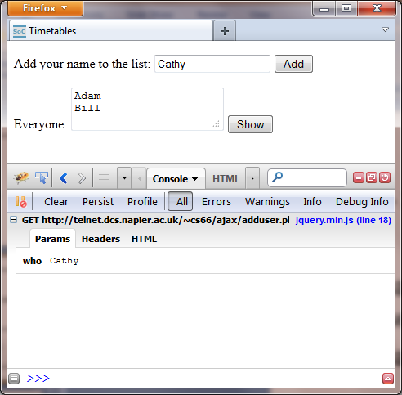
Firebug Console
Firebug will show the data going from the browser to the server.
Each exchange has Params and HTML.

Slide 7
Getting a result
The ajax call now has a success function associated.
This function will run when the browser receives a response.
The call is asynchronous.
$('#show').click(function(){
$.ajax({url:'users.txt',success:function(d){
$('#everyone').val(d);
}})});

